Slide 1
COMS10003: Dealing with Uncertainty
Random Variables I
Andrew Calway

Slide 2
Central Limit Theorem
Histograms of values:
~uniform
N=8
N=16
N=1000
Histograms of sums:
~normal
N=16
N=100
N=1000

Slide 3
Random Variables
Event
Random Variable
Mapping from sides to numbers
Outcome
i.e. 1 of 6 possible sides

Slide 4

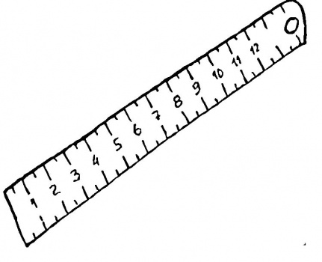
Random Variables
Fish
length
measure the fish

Slide 5
Discrete Random Variables
Discrete random variable:
Probability mass function:
Probability of being :
Probability ranges from
0 (never) to 1 (always)
and must always have a value

Slide 6
Relative Frequency
If we observe values of the discrete random variable over time and count the number of times it has value , denoted , then:
Hence:
Gets closer
as gets
bigger
count
Histogram of
observations
:

Slide 7
Distribution Function
(cumulative) Distribution function (cdf):
For discrete RV:
1.0
0.2

Slide 8
Continuous Random Variable
If can have any value within a continuous range → doesn’t make sense to define probability of it having one particular value (infinite number of options)
Instead, define probability of falling in some interval:
Probability Density
Function (pdf)

Slide 9
Distribution and Density
Uniform
density
1.0

Slide 10
Density and Histograms

Slide 11
Marginal Densities
Joint Density
Function
Given two RVs and :
Marginal densities

Slide 12
Independence
RVs and are independent iff

Slide 13
Expected Value (Mean)
discrete
average
value if
we observe
‘for ever’
continuous
Given sample
Sample
mean

Slide 14
Variance
Standard
deviation
discrete
Expected deviation from the mean
continuous
Given sample
Sample variance
Gives unbiased estimate of variance

Slide 15
Scaling and Adding RVs
Given RVs and and scalars and
Given independent RVs and

Slide 16
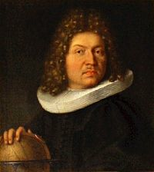
Bernoulli Distribution
Two value random variable, e.g.
probability of being 1
probability of being 0
Jacob
Bernoulli
p
(1-p)
0
1

Slide 17
Binomial Distribution
RV - number of times one value occurs in n independent two value experiments, e.g. coin flipping H or T
Probability of getting k heads in n flips
# of k combinations in n

